Slide 1
SDS 2 Exam
Horror Movie Reviews

Slide 2
Problem statement and approach
IMDB review dataset -> Horror Movie Reviews
Problem thesis: What is most central in reviews regarding the 'A Nightmare on Elm Street' movie and what is the sentiment regarding this movie?
Setting up data to get:
Network relationships
Centrality measures
Network structure indicators
Bi-partite network
Analysing the dataset
Setfit to make text classification
BERTopic to visualize different topics and themes
Notes:
Network Relationships:
Identify clusters/themes within reviews (e.g., common opinions, emotions).
Centrality Measures:
Highlight key words/concepts most frequently or strongly connected.
Network Structure Indicators:
Examine network structure (e.g., clusters, cohesion) to understand review diversity.
Bi-partite Network:
Link reviewers to themes/topics to explore audience segmentation.
Sentiment Analysis (SetFit):
Classify reviews as positive, negative, or neutral.
Topic Modeling (BERTopic):
Extract and visualize key themes (e.g., characters, horror elements).

Slide 3
Different centrality measures and their results
Top entities based on nx.degree_centrality = ('Elm Street', 0.6625514403292182), ('two', 0.6255144032921811), ('Nightmare', 0.4814814814814815)
Top entities by weighted centrality: (('Elm Street', 'FAC'), 0.5151515151515151), (('two', 'CARDINAL'), 0.48484848484848486), (('Wes Craven', 'PERSON'), 0.4545454545454546)
Based on bipartite
Top entities by degree centrality: (('Elm Street', 'FAC'), 0.5151515151515151), (('two', 'CARDINAL'), 0.48484848484848486), (('Wes Craven', 'PERSON'), 0.4545454545454546)
Top entities by betweenness centrality: (('Elm Street', 'FAC'), 0.3459483225108226), (('Wes Craven', 'PERSON'), 0.24303300865800864), (('two', 'CARDINAL'), 0.2380862193362193)
Top entities by eigenvector centrality: (('two', 'CARDINAL'), 0.3572778460648231), (('Wes Craven', 'PERSON'), 0.3396668706839594), (('Elm Street', 'FAC'), 0.3283272726241945)
Notes:
Based on nx.degree_centrality
The entities with greatest importance for centrality is "Elm Street", "two" and "Nightmare", these keywords represtent connected titles in the network and as expected are connected to the title of the movie. Futhermore "Wes Craven's" has a high centrality which makes sence sincde the film are directed/produced by him.
The scores shows there is not a extreme influence of one keyword, but more spread influence.
Weighted centrality
The top entities based on weighted centrality is found. Here it can be notessed that Elm street, the producer and persons in general is very central for the reviews.
Based on bipartite It can be seen in the results that even though different centrality measueres is used there are very little change in the key entities. The differences in the results are caused by the differences in the methods. The methods used is:
Degree Centrality
- Shows the most direct connections to other entities.
Betweenness Centrality
- Shows which entities help as connections to other entities another way of expressing the relationship is that its the entities that lies between other entities the most.
Eigenvector Centrality
- Shows the influence of entities within the network as the most central eg. two, wes craven and elm street often is connected to other central entities.

Slide 4
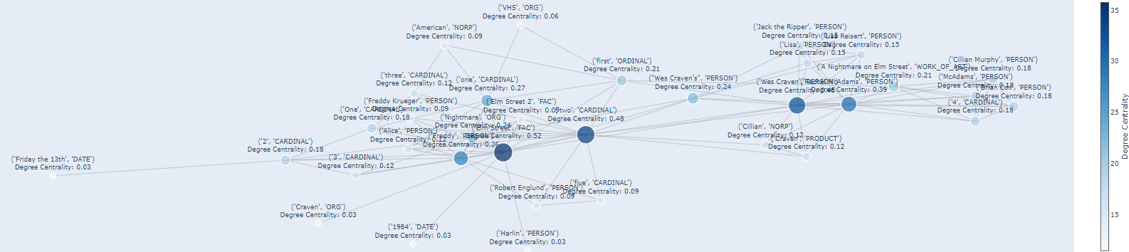
Entities projection network
This network shows several prominent entities such as Elm Street, Wes Craven and so on which is also shown above.
Each node’s size and color intensity represent its degree centrality, showing the number of direct connections (shared entities or themes) it has with other nodes. Nodes with higher degree centrality are larger and darker, indicating they have more connections or edges in the network.
There is pramarily two clusters in the network that is clusterd around either Elm street or the persons Rachel McAdams or Wes Craven. It is also clear that there is a distinction of persons and what we can assume is whats happening or regarding elm street.

Slide 5
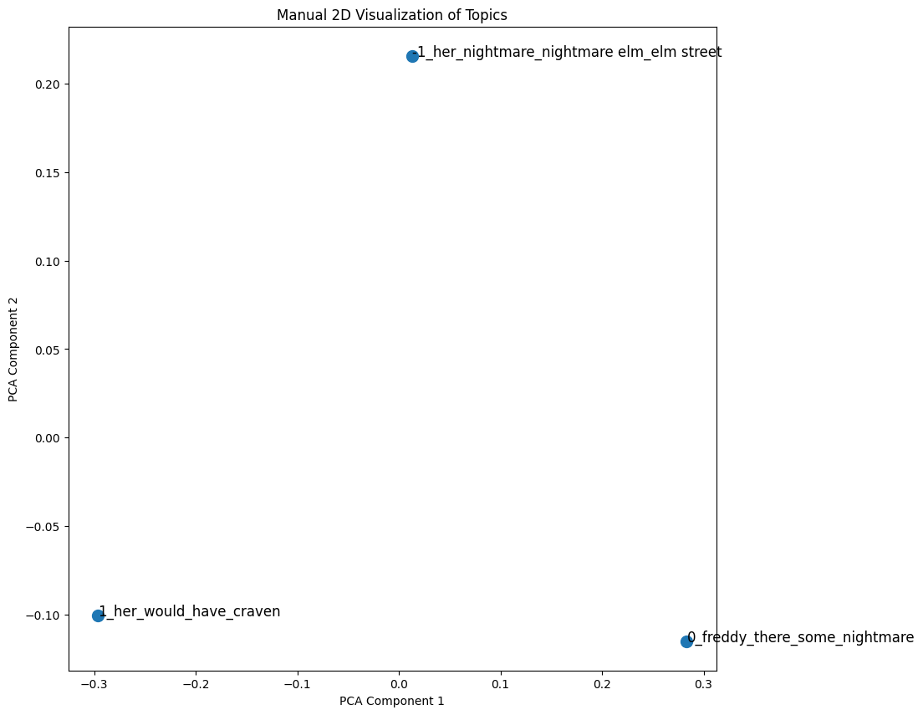
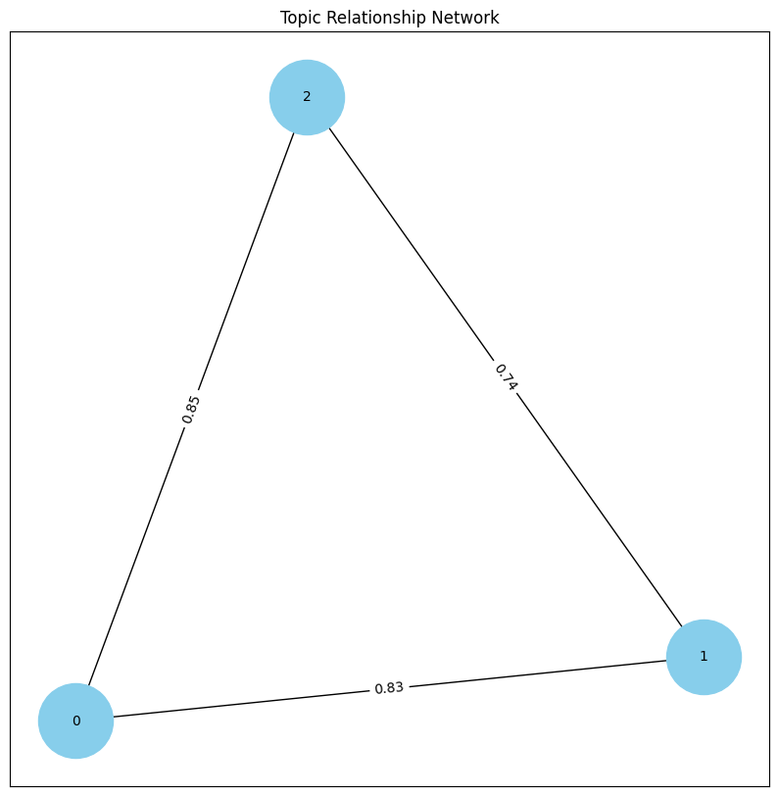
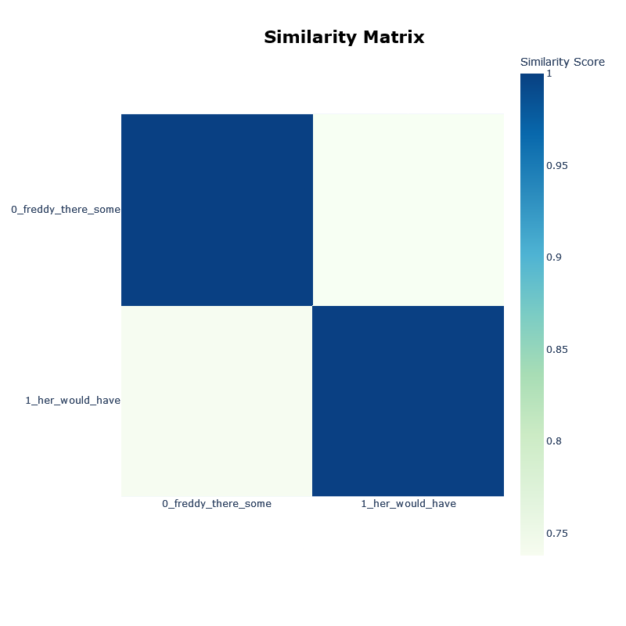
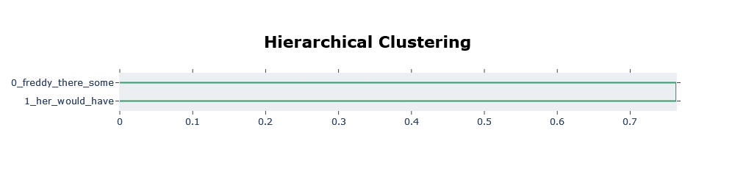
Visualizations of themes and topics
Notes:
1. Manual 2D Visualization of Topics (Left Plot)
Description: This is a 2D scatter plot based on PCA components.
Topics that are closer to each other on this plot are more similar in terms of the themes or keywords they contain.
The spread and positioning indicate the level of variation or distinctiveness between topics.
2. Topic Relationship Network (Center Plot)
Description: This is a network diagram showing the relationships or connections between different topics, with numbers indicating the strength of connections.
Nodes represent individual topics, and edges (lines) between them indicate connections based on similarity scores.
The thickness of the edges or proximity of nodes may correlate with the similarity or relationship strength.
3. Similarity Matrix (Right Plot)
Description: A heatmap matrix displaying the similarity scores between pairs of topics.
Darker blue areas represent higher similarity between topics, while lighter areas indicate lower similarity.
The matrix is symmetric, with the diagonal representing perfect similarity (self-similarity) for each topic.
Allows a quick, quantitative comparison between all pairs of topics.
4. Hierarchical Clustering (Bottom Plot)
Description: A dendrogram showing the hierarchical clustering of topics based on similarity.
Topics are placed on a scale indicating the level of similarity required to cluster them together.
Clusters are formed at various similarity thresholds, providing a layered view of topic grouping.
Summary
These visualizations collectively provide insights into thematic relationships and structures within the data. The PCA plot and network diagram visually group topics, the similarity matrix quantifies pairwise similarities, and the hierarchical clustering diagram shows how topics can be grouped at different levels of similarity. Together, they offer a comprehensive view of the underlying topic structure.

Slide 6
Key findings and insights
Network
2 clusters of importance in the movie 'A Nightmare on Elm Street' one centered around Elm Street the other around prominent persons either in the movie or associated with the characters in the movie.
Text classification
Using the SetFit method the sentiment in the small batch of reviews was able to create accurate sentiment predictions.
Topic modeling
It is found that there is some distinction between the characters in the movie (clusters). The Topic model shows a clear distinction between Freddy and Her which must be related to the female lead character. The plots show varying levels of overlap in the reviews, with some overlaps having stronger connections than other.

